Slide 1





Instrumental Systematics and the Impact on 21-cm Measurements of the Epoch of Reionization
Lily Whitler
Department of Physics, Arizona State University
Advisors: Adam Beardsley and Danny Jacobs
School of Earth and Space Exploration, Arizona State University
April 13, 2019
Arizona Space Grant Consortium Statewide Symposium

Slide 2
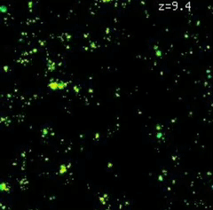
The Epoch of Reionization (EoR)
Emergence of first luminous sources
Ionization of neutral hydrogen
Several hundred million years - 1 billion years after the Big Bang
Important for understanding structure formation
by Matt McQuinn
1
1

Slide 3
Observational Challenges
Galactic and extragalactic radio
foregrounds
Ionospheric distortion
Radio frequency interference
Instrumental effects
  Calibration errors
2

Slide 4
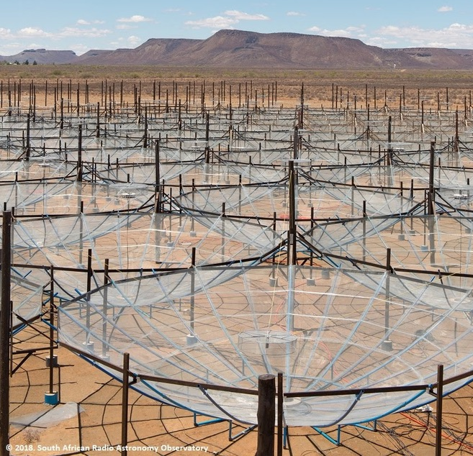
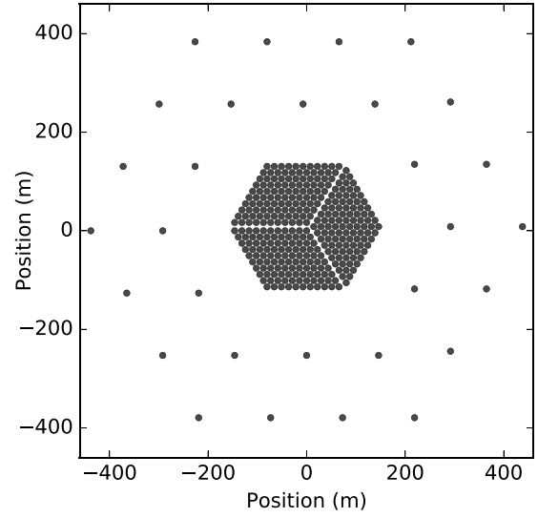
The Hydrogen Epoch of Reionization Array (HERA)
© South African Radio Astronomy Observatory
Deboer et al. (2017)
This material is based upon work supported by the National Science Foundation under Grant No. 1636646, the Gordon and Betty Moore Foundation, and institutional support from the HERA collaboration partners. HERA is hosted by the South African Radio Astronomy Observatory, which is a facility of the National Research Foundation, an agency of the Department of Science and Technology.
3

Slide 5
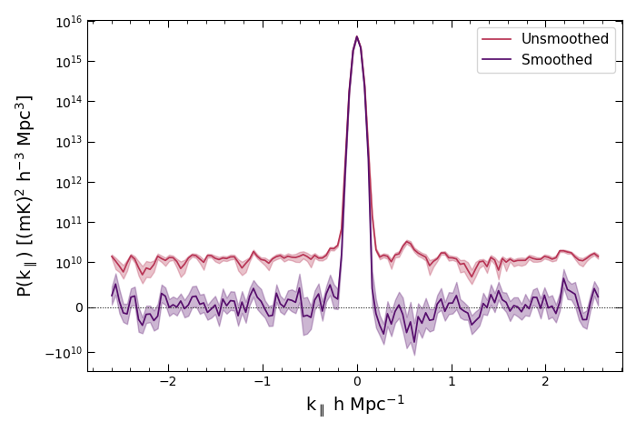
Calibration Systematics in Real Data
4

Slide 6
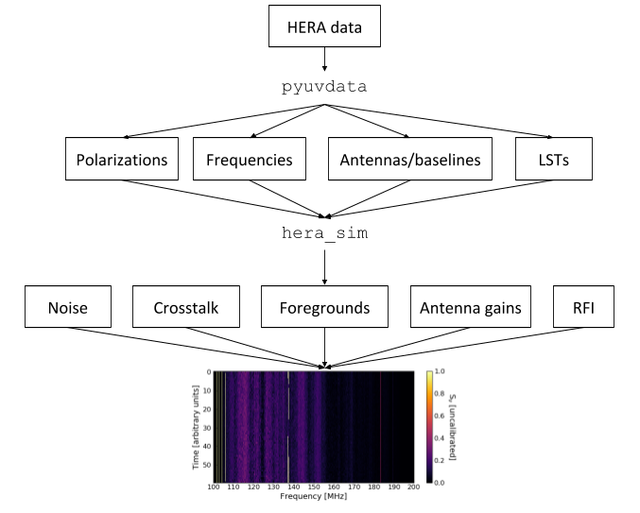
Simulating HERA Data
5

Slide 7
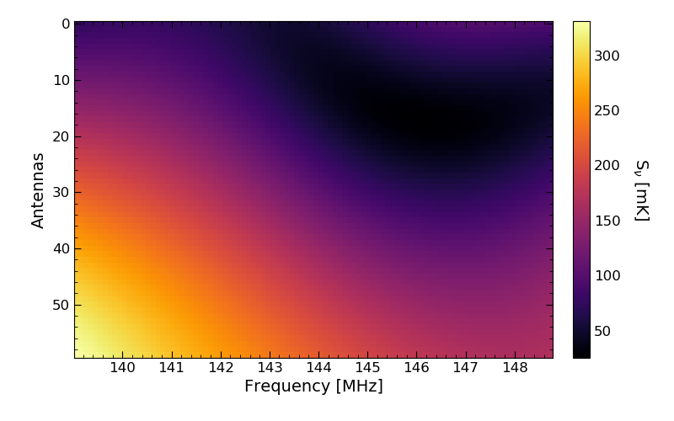
Simulating HERA Data
6

Slide 8
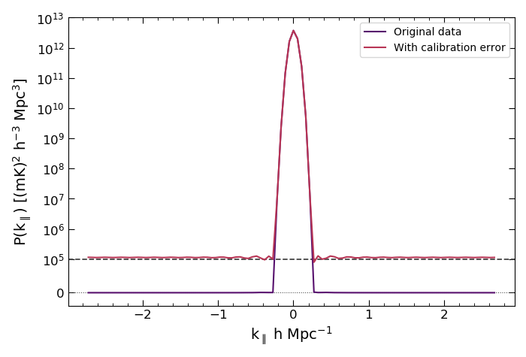
Calibration Systematics in Simulated Data
~EoR level
7

Slide 9
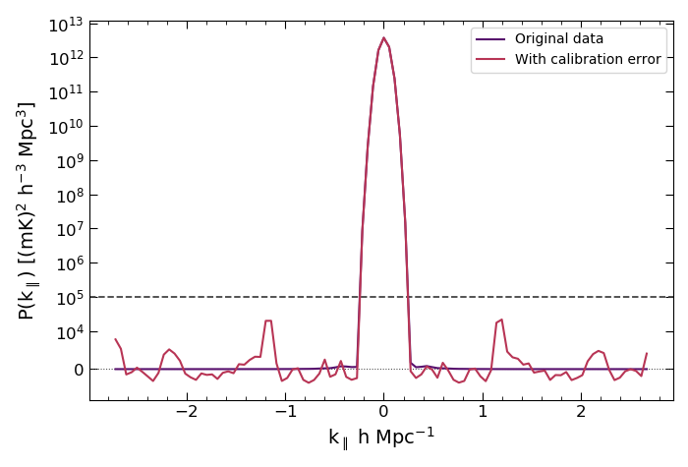
Calibration Systematics in Simulated Data
~EoR level
8

Slide 10
Summary and Future Work
Precise and accurate calibration is essential for measuring the EoR
Simulations help us to understand the patterns we see in the real data
Future work: continue building up models of various instrumental systematics and their effect on the power spectrum
Questions? Email me:
Lily Whitler
lwhitler@asu.edu
9

